Slide 1
Chapter 4 Selection Structures: Making Decisions

Slide 2
4.1 An Introduction to Selection Structures
Single-alternative (If-Then)
A single block of statements to be executed or skipped
Dual-alternative (If-Then-Else)
Two blocks of statements, one of which is to be executed, while the other one is to be skipped
Multiple-alternative (If-Then-Else-If or Case/Switch)
More than two blocks of statements, only one of which is to be executed and the rest skipped

Slide 3
Single Alternative
If something is true Then
Do something (any
number of statements)
End If
Write “How old are you?”
Input Age
If Age >= 18
Set Eligibility = “Yes”
Write “You can vote.”
Do other things…
End If

Slide 4
Dual Alternative
If something is true Then
Do something
Else
Do something else
End If
Write “How old are you?”
Input Age
If Age >= 18
Set Eligibility = “Yes”
Write “You can vote.”
Else
Set Eligibility = “No”
Write “You’re too young.”
End If

Slide 5
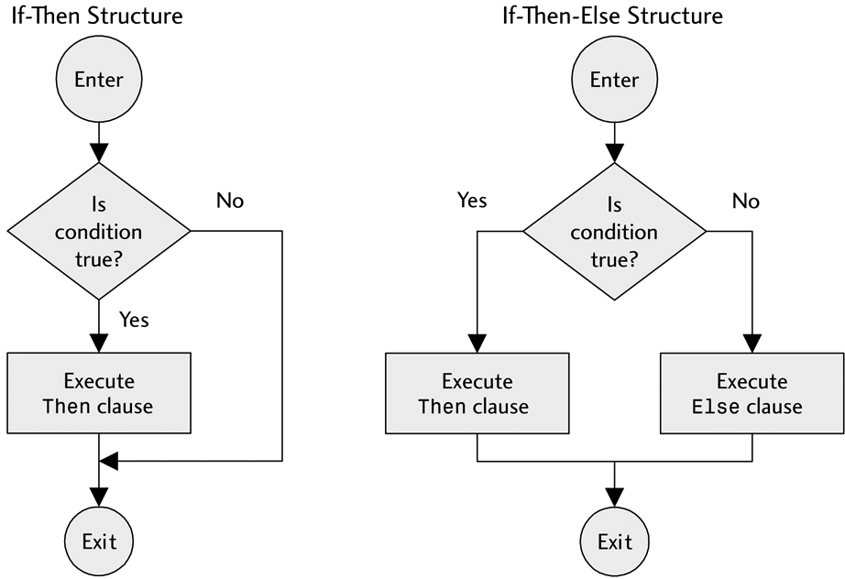
Flowcharts for Selection Structures: Single Alternative and Dual Alternatives

Slide 6
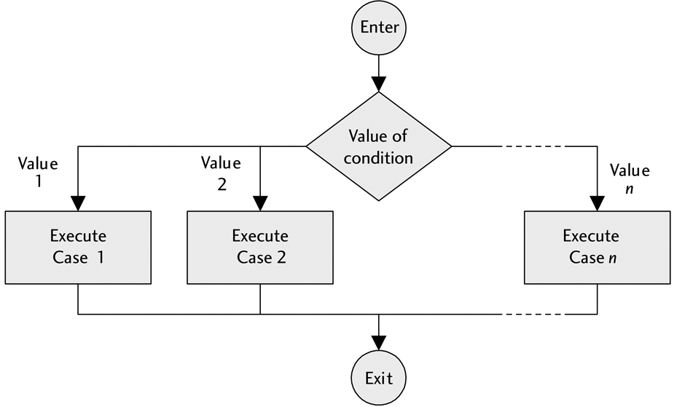
Flowcharts for Selection Structures: Multiple Alternative

Slide 7
Guidelines
An Else condition does not have to exist. Sometimes we only want to do something if something is true and do nothing if it is not true.
Do not manufacture alternative conditions.
In an If statement, the body of the If is executed if, and only if, the test condition is true. Otherwise, no action is taken.
Be sure to indent for readability.

Slide 8
Example: two ways to write a test condition
Write “Do you have any children? 
Type Y for yes, N for no”
Input Response
If Response is “Y” Then
Write “How many?”
Input NumberChildren
End If
Write “Questionnaire is complete.
Thank you.”
Write “Do you have any children? 
Type Y for yes, N for no”
Input Response
If Response is not “N” Then
Write “How many?”
Input NumberChildren
End If
Write “Questionnaire is complete.
Thank you.”

Slide 9
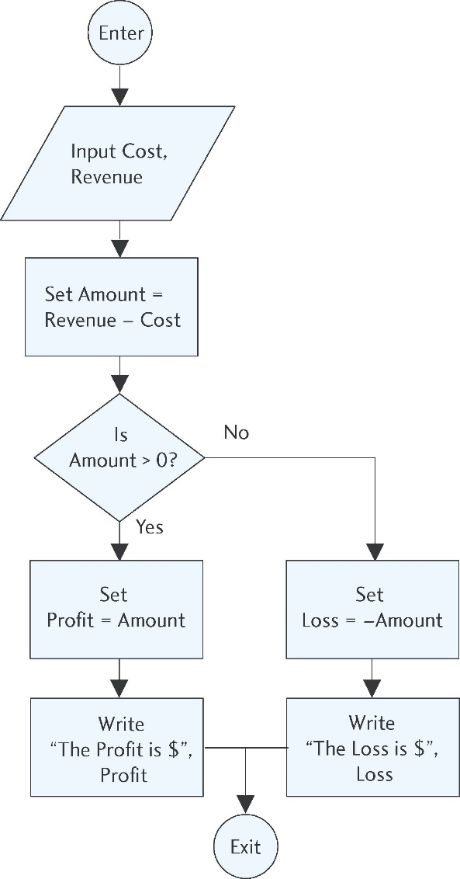
Example: Multiple Alternatives
1 Write “Enter total cost:”
2 Input Cost
3 Write “Enter total revenue:”
4 Input Revenue
5 Set Amount = Revenue – Cost
6 If Amount > 0 Then
7 Set Profit = Amount
8 Write “The profit is $” + Profit
9 Else
10 Set Loss = –Amount
11 Write “The loss is $” + Loss
12 End If

Slide 10
4.2 Relational and Logical Operators
Decision making involves testing a condition
To help construct these conditions use
relational operators
logical operators

Slide 11
Relational Operators
Relational operators are the symbols used in the condition to be evaluated in If statements:
= = is the same as (the comparison operator)
!= is not the same as (not equal to)
< less than
> greater than
<= less than or equal to
>= greater than or equal to

Slide 12
Example
Assume the variables A and B have the values:
A = 9, B = 6
Then the If statement:
If A > B Then
Write A + ”is greater than” + B
End If
can be read:
“If it is true that the value of the variable A is greater than the value of the variable B, then write the value of B to the screen.”
The display will be:
9 is greater than 6

Slide 13
More examples:
Given: A = 23, B = 16
Then:
A > B is true
A < B is false
A >= B is true
A <= B is false
A != B is true
A == B is false

Slide 14
Comparison vs. Assignment Operators
There is a significant difference between the use of an equals sign (=) as the assignment operator and a double equals sign (==) as the comparison operator.
As an assignment operator, the equals sign sets the value of an expression on the right side to the variable on the left side.
As a comparison operator, the double equals sign asks the question, “Is the value of the variable on the left side the same as the value of the expression, number, or variable on the right side?”
a single equals sign (=) signifies the assignment operator
a double equals sign (==) signifies the comparison operator

Slide 15
The Assignment Operator
Given: A = 14, B = 27
In programming code, the assignment statement:
A = B
sets the value of B to the variable A.
In other words, after this statement is executed, both A = 27 and B = 27.
In this case, the equals sign is used as an assignment operator.

Slide 16
The Comparison Operator
Given: A = 14, B = 27
Using relational operators, the statement:
A == B
is a comparison.
This statement asks the question, “Is the value of A the same as the value of B?” In this case, since A and B have different values, the answer is “no” and the statement would result in a value of False.

Slide 17
Two ways to obtain a positive result
If Number >= 0 Then
Write Number
Else
Set PosNum = -Number
Write PosNum
End If
If Number < 0 Then
Set PosNum = -Number
Write PosNum
Else
Write Number
End If

Slide 18
Be careful! Do these two give the same result?
If Age > 16 Then
Write “You can drive!”
Else
Write “Sorry, you’re too young.”
End If
If Age < 16 Then
Write “Sorry, you’re
too young.”
Else
Write “You can drive!”
End If

Slide 19
Logical Operators
Logical operators are used to connect simple conditions into a more complex condition called a compound condition.
The simple conditions each contain one relational operator.
Using compound conditions reduces the amount of code that must be written.
Three logical operators we will use: AND, OR, NOT

Slide 20
Logical operators can save space: The following are equivalent
Input X
If X < 5 Then
Write “OK”
End If
If X > 10 Then
Write “OK”
End If
Input X
If (X < 5) OR (X > 10) Then
Write “OK”
End If

Slide 21
The AND Operator
A compound condition consisting of two simple conditions joined by an AND is true only if both simple conditions are true.
It is false if even one of the conditions is false.
The statement:
If (X > 5) AND (X < 10) Then …
is true only if X is 6, 7, 8, or 9. It has to be both greater than 5 and less than 10 at the same time.

Slide 22
The OR Operator
A compound condition consisting of two simple conditions joined by an OR is true if even one of the simple conditions is true.
It is false only if both are false.
For example:
If (Response ==“Y”) OR (Response ==“y”) Then …
This is true if Response is uppercase (‘Y’) or lowercase (‘y’). For the above condition to be false, Response would have to be something other than either ‘Y’ or ‘y’.

Slide 23
The NOT Operator
AND and OR affect 2 simple conditions.
NOT affects only one condition. If you need to negate more than one simple condition, you will need more than one NOT.
A condition with the NOT operator is true only if the condition is false.
NOT(A < B)
is true only if B is greater than or equal to A.
If (X > 100) AND NOT(X == Y) Then…
is true only if X is greater than 100 but not equal to the value of Y.

Slide 24
Truth Tables for OR, AND, and NOT Operators
X | Y | X OR Y | X AND Y | NOT X
true | true | true | true | false
true | false | true | false | false
false | true | true | false | true
false | false | false | false | true

Slide 25
Hints
In a compound condition, it is necessary to use complete simple conditions.
This is correct:
If (X < 5) OR (X > 10) Then …
This is not correct:
If (X < 5 OR > 10) Then …

Slide 26
Example: First way using AND Workers who earn less than $10 per hour are paid 1.5 times their normal rate for overtime hours. Workers who earn $10 or more per hour are paid their regular hourly rate regardless of number hours worked. Working more than 40 hours per week is considered overtime.
1 If (PayRate < 10) AND (Hours > 40) Then
2 Set OvertimeHours = Hours – 40
3 Set OvertimePay = OvertimeHours * 1.5 * PayRate
4 Set TotalPay = 40 * PayRate + OvertimePay
5 Else
6 Set TotalPay = Hours * PayRate
7 End If

Slide 27
Example: Second way using OR Workers who earn less than $10 per hour are paid 1.5 times their normal rate for overtime hours. Workers who earn $10 or more per hour are paid their regular hourly rate regardless of number hours worked. Working more than 40 hours per week is considered overtime.
1 If (PayRate >= 10) OR (Hours <= 40) Then
2 Set TotalPay = Hours * PayRate
3 Else
4 Set OvertimeHours = Hours – 40
5 Set OvertimePay = OvertimeHours * 1.5 * PayRate
6 Set TotalPay = 40 * PayRate + OvertimePay
7 End If

Slide 28
Side by side comparison
1 If (PayRate >= 10) OR (Hours <= 40) Then
2 Set TotalPay = Hours * PayRate
3 Else
4 Set OvertimeHours = Hours – 40
5 Set OvertimePay = OvertimeHours * 1.5 * PayRate
6 Set TotalPay = 40 * PayRate + OvertimePay
7 End If
1 If (PayRate < 10) AND (Hours > 40) Then
2 Set OvertimeHours = Hours – 40
3 Set OvertimePay = OvertimeHours * 1.5 * PayRate
4 Set TotalPay = 40 * PayRate + OvertimePay
5 Else
6 Set TotalPay = Hours * PayRate
7 End If

Slide 29
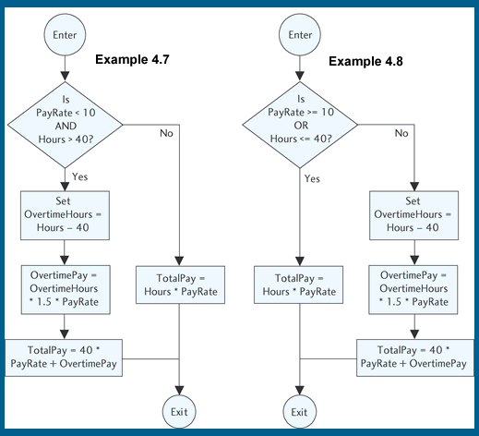
Flowcharts for the two ways:

Slide 30
Hierarchy of Operations (Order of Precedence)
Description | Symbol
Arithmetic Operators are evaluated first in the order listed
First: Parentheses | ( )
Second: Exponents | ^
Third: Multiplication / Division / Modulus | *, /, %
Fourth: Addition / Subtraction | + –
Relational Operators are evaluated second and all relational operators have the same precedence
Less than | <
Less than or equal to | <=
Greater than | >
Greater than or equal to | >=
The same as, equal to | ==
Not the same as | !=
Logical Operators are evaluated last in the order listed
First: NOT | ! or NOT or not
Second: AND | && or AND or and
Third: OR | || or OR or or

Slide 31
Combining Logical and Relational Operators
Example:
Let Q = 3 and let R = 5
Is the following expression true or false?
NOT Q > 3 OR R < 3 AND Q – R <= 0
Step 1: (NOT(false)) OR (false AND true)
Step 2: true OR (false AND true)
Step 3: true OR false
Step 4: true

Slide 32
The Boolean Type
Most programming languages allow variables to be of logical (or Boolean) type.
A Boolean variable may only be either true or false.
Example: Can declare a variable, Answer, to be of Boolean type and use it in a statement anywhere that a value of true or false is valid, such as the following C++ snippet:
bool Answer;
Answer = true;
if(Answer) cout << “Congratulations!”;
This means: If the value of Answer is true, then write “Congratulations!” to the screen.
The following C++ statement is equivalent to the if statement shown above and may be clearer:
if (Answer == “true”) cout << “Congratulations!”;

Slide 33
4.3 ASCII Code and Comparing Strings
A character can be defined as any symbol that can be typed on the keyboard.
These symbols include special characters like asterisks (*), ampersands (&), @ signs, as well as letters, digits, punctuation marks, and blank spaces.
There is a more precise definition of a character using how characters are represented in a computer’s memory.
Relational operators <, <=, >, !=,==, and >= can be applied to any string of characters.

Slide 34
ASCII Code
A programming language uses a scheme to associate each character with a number.
The standard is the American Standard Code for Information Interchange (ASCII code).
All data, including characters, are stored in the computer’s memory in binary form.
It is pronounced “askey.”
Each character is associated with a number from 0 to 127.
Examples:
Uppercase A is 65
Uppercase Z is 90
Digits have codes from 48 (“0”) to 57 (“9”)

Slide 35
Ordering Arbitrary Strings
Letters are in alphabetical order.
All uppercase letters precede all lowercase letters.
Digits (viewed as characters) retain their natural order.
For example, “1” < “2”, “2” < “3”
The blank precedes all digits and letters.
Examples: All of the following conditions are true:
“a” > “B”
“1” <= “5”
“2” >= “2”

Slide 36
Rules for Ordering Strings
Two strings, S1 and S2, are equal (S1 == S2) if they have exactly the same characters in exactly the same order; they are not equal (S1 != S2) otherwise. To see which of two unequal strings comes first, use the following procedure:
1. Scan strings from left to right, stopping at the first position for which the
corresponding characters differ or when one of the strings ends.
2. If two corresponding characters differ before either string ends, the ordering of
these characters determines the ordering of the given strings.
3. If one string ends before any pair of corresponding characters differ, then the
shorter string precedes the longer one.
When applying this procedure, the following is true:
• If string S1 precedes string S2, then S1 < S2.
• If string S1 follows string S2, then S1 > S2.

Slide 37
Beware of Strings of Digits
A character string may be numbers like “123”. But “123” is not the same as 123.
The numeric constant is stored in memory by storing the binary equivalent of 123, but the string constant is stored in memory by successively storing the ASCII codes for “1”, “2”, and “3”.
There is no mechanism to compare numbers with strings so, if the variable (Num) is a numeric variable, statements like the following:
Num == “123”
make no sense, and will lead to an error message if used in a program.
Also, using the procedure given for ordering strings, we see that:
”123” < “25” and “24.0” != “24”
are both true statements!

Slide 38
4.4 Selecting from Several Alternatives
To handle more than two options in a program we use multiple If-Then statements or multiple If-Then-Else statements.
If (something is true) Then
Do something
Else
If (something else is true) Then
Do something else
Else
Do a different something else
End If
End If

Slide 39
Example
If Age >= 18 Then
Set Eligibility = “Yes”
Else
If Age > 15 Then
Set Eligibility = “Maybe”
Else
Set Eligibility = “No”
End If
End If

Slide 40
Hints
The number of End If’s must equal the number of If’s.
You can draw a line to connect them to check.
In the previous example, the check for Age > 15 will never be done if the Age is >= 18.
Regardless of how many possible conditions are included, only one will ever be executed.

Slide 41
Assigning Ratings the Long Way
1 Declare Score As Integer
2 Declare Rating As Character
3 Write “Enter score: “
4 Input Score
5 If Score == 10 Then
6 Set Rating = “A”
7 End If
8 If (Score == 8) OR (Score == 9) Then
9 Set Rating = “B”
10 End If
11 If (Score == 6) OR (Score == 7) Then
12 Set Rating = “C”
13 End If
14 If (Score >= 1) AND (Score <= 5) Then
15 Set Rating = “D”
16 End If

Slide 42
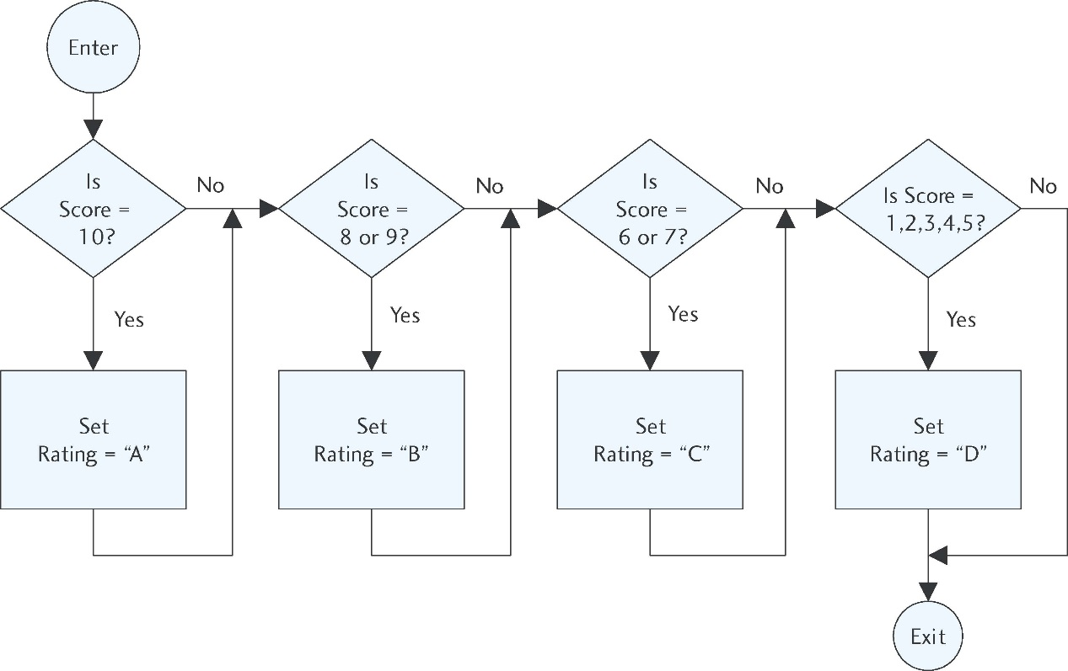
Assigning Ratings the
Long Way

Slide 43
Assigning Ratings the Nested If-Then-Else Way
1 Declare Score As Integer
2 Declare Rating As Character
3 Write “Enter score: “
4 Input Score
5 If Score == 10 Then
6 Set Rating = “A”
7 Else
8 If (Score == 8) OR (Score == 9) Then
9 Set Rating = “B”
10 Else
11 If (Score == 6) OR (Score == 7) Then
12 Set Rating = “C”
13 Else
14 Set Rating = “D”
15 End If
16 End If
17 End If

Slide 44
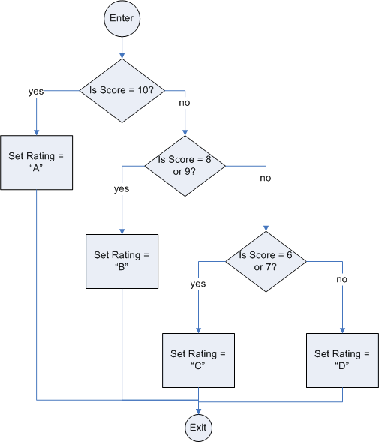
Assigning Ratings the
Nested If-Then-Else Way

Slide 45
Using Case-Like (or Switch) Statements
Select Case Of ??? test expression to be evaluated
Case 1st value:
Statements execute if test expression is a match
Break out of Cases
Case 2nd value:
Statements execute if test expression is a match
Break out of Cases
Case 3rd value:
Statements execute if test expression is a match
Break out of Cases
.
. all the rest of the values that can be chosen
.
Case nth value:
Statements execute if test expression is a match
Break out of Cases
Default:
Statements execute if test expression does not match any of the above
End Case

Slide 46
Assigning Ratings Using a Case Statement
1 Declare Score As Integer
2 Declare Rating As Character
3 Write “Enter score: “
4 Input Score
5 Select Case Of Score
6 Case 10:
7 Set Rating = “A”
8 Break
9 Case 8, 9:
10 Set Rating = “B”
11 Break
12 Case 6, 7:
13 Set Rating = “C”
14 Break
15 Case 1–5:
16 Set Rating = “D”
17 Break
18 End Case

Slide 47
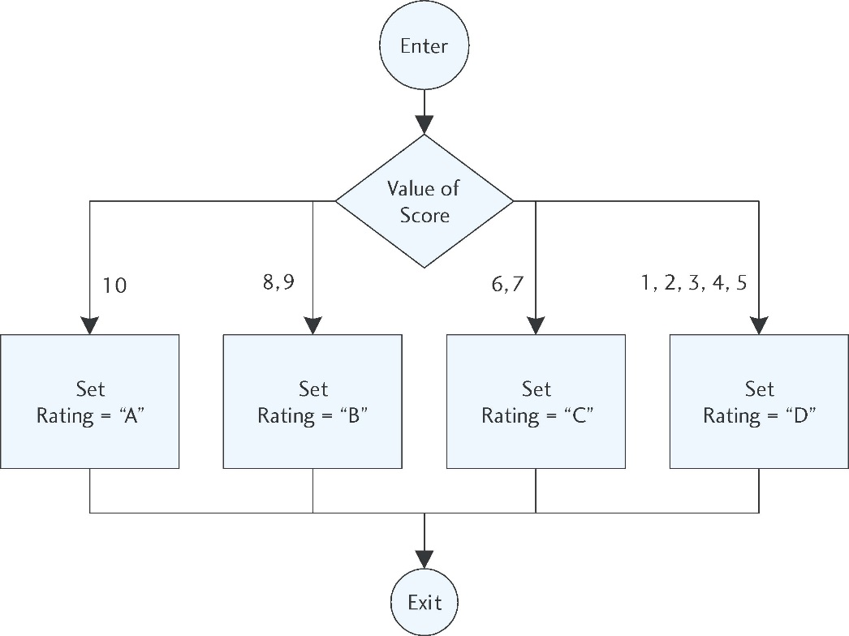
Assigning Ratings using
A Case Statement

Slide 48
4.5 Applications of Selection Structures
Defensive Programming:
Program defensively in order to prevent bad data from entering our program. To do this, set error traps.
If our program should accept only a Cost greater than 0, we can stop any other value from entering with the following trap:
Input Cost
If Cost <= 0 Then
Write “Invalid cost”
Else
Write “The cost is ” + Cost
End If

Slide 49
Error Trap for a Division by Zero Error
The reciprocal of a number is 1 divided by that number. But division by zero is not allowed ao the reciprocal of 0 is undefined. The following example will display the reciprocal of any number:
Write “Enter a number.”
Write “This program will display its reciprocal.”
Input Number
If Number != 0 Then
Set Reciprocal = 1/Number
Write “The reciprocal of “ + Number + “ is “ + Reciprocal
Else
Write “The reciprocal of 0 is not defined.”
End If

Slide 50
Avoiding Illegal Operations: the Sqrt() function
The following program segment displays the square root of a number unless the number is negative:
Write “Enter a number:”
Write “This program will display its square root.”
Input Number
If Number >= 0 Then
Write “The square root of “ + Number + “ is “ + 
Sqrt(Number)
Else
Write “The square root of “ + Number + ” is not defined.”
End If

Slide 51
Defensive Programming
Be sure to test your program by “playing computer.”
This is also called “desk checking.”
Perform all calculations multiple times manually or with a calculator.
Use data that will show the results when each branch of each selection structure is executed at least once.
Check for division by zero, negative values for a square root function, and any other special conditions.

Slide 52
Menu-Driven Programs
A major goal of a programmer is to create user friendly programs.
When the user has many options, menus are often used.
Such programs are menu-driven.
Menus are usually arranged in a row near the top of the screen.
The user clicks the mouse on the desired choice.
The main menu (a list of the program’s major functions) is usually the first thing the user sees.

Slide 53
Sample Menu
The Legendary Lawn Mower Company Inventory Control
Leave the program ................... Enter 0
Add an item to the list .............. Enter 1
Delete an item from the list ...... Enter 2
Change an item on the list ........ Enter 3

